Slide 1
Calculo Numérico I Eigenvalores
Dr. Luis Sanchez

Slide 2
Eigenvalue Problems
Determine the eigenvalues for n homogenous linear equations in n unknowns
Non-homogeneous system
homogeneous system

Slide 3
Mathematical Background
For nontrivial solutions ==>
Characteristic polynomial: det( ) = f_{n}( )
The root of f_{n}( ) = 0 are the solutions for the eigenvalues

Slide 4
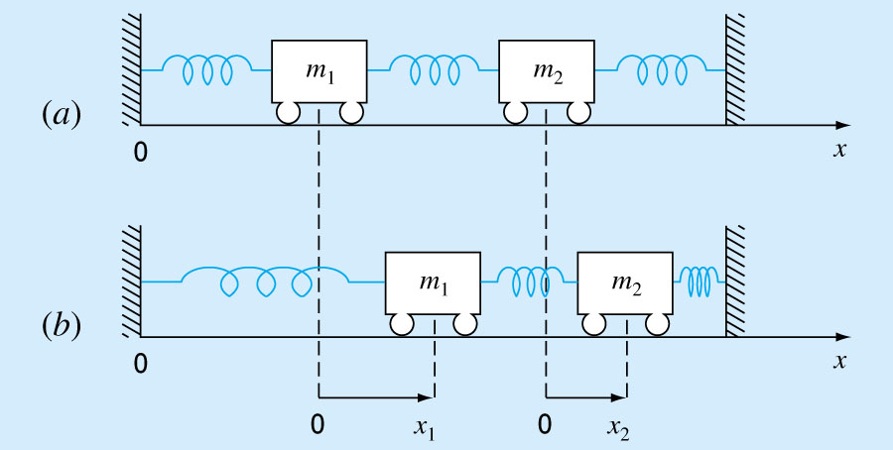
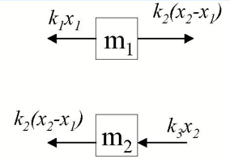
Mass-Spring System
Equilibrium positions

Slide 5
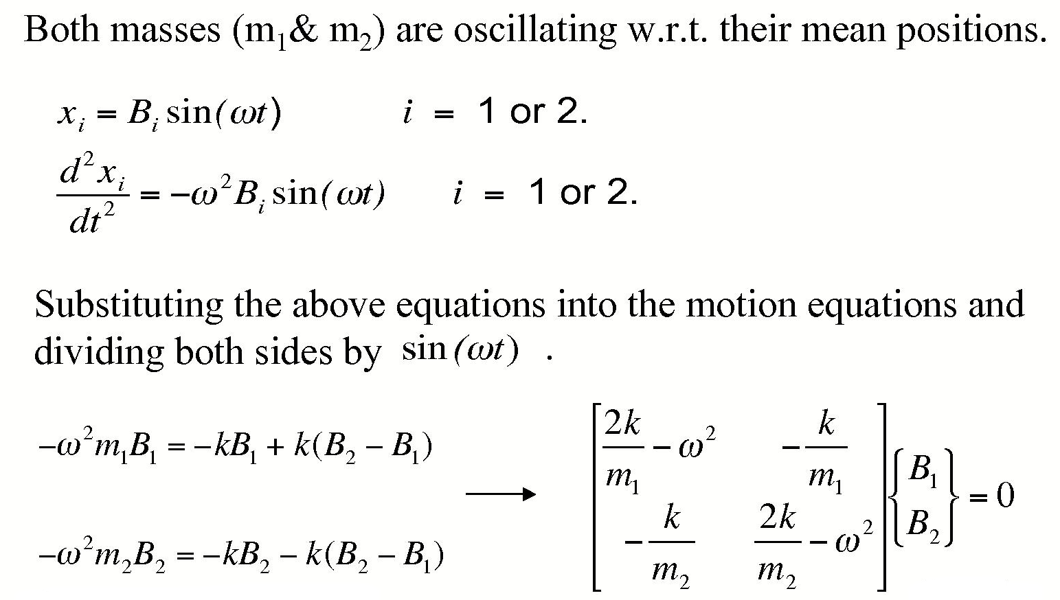
Mass-Spring System
Physics of Eigenvalues

Slide 6
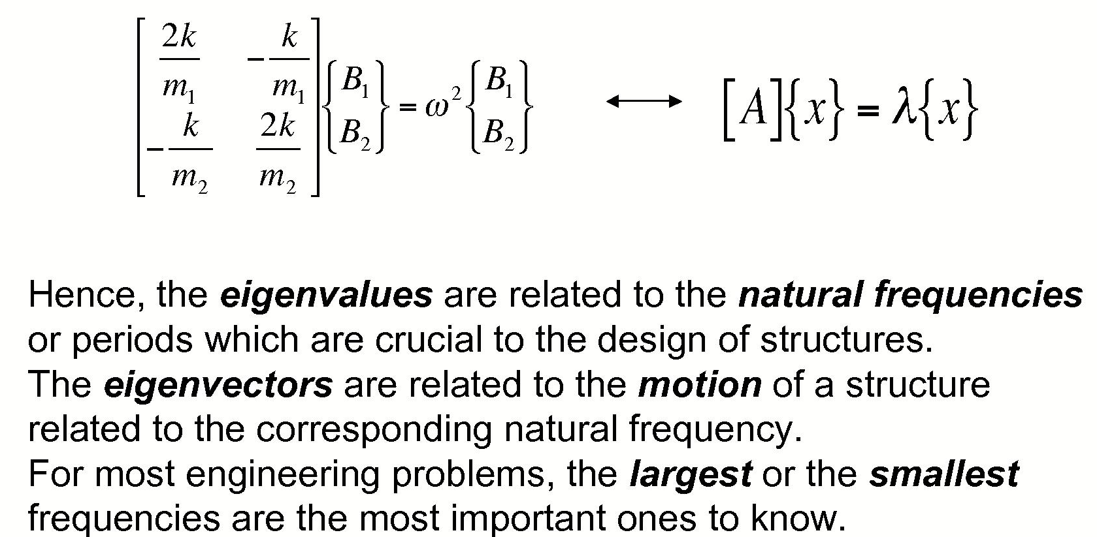
Physics of Eigenvalues

Slide 7
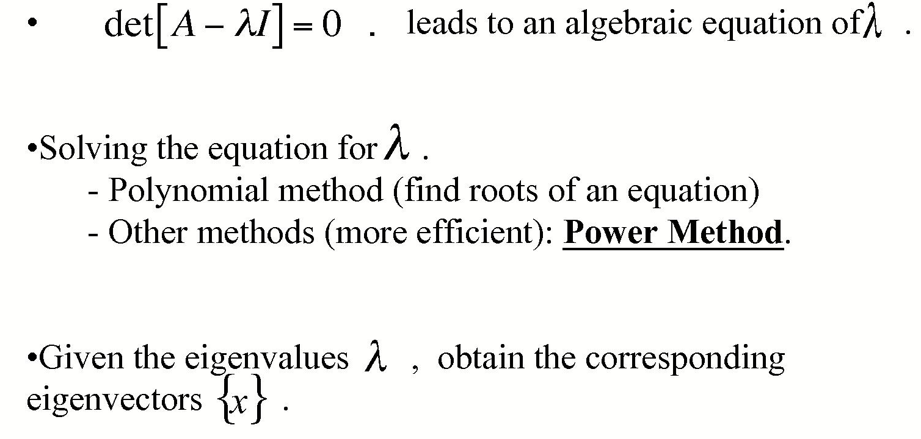
Steps of Solving Eigen-value Problems

Slide 8
Polynomial Method Applied on Mass-Spring System
m₁ = m₂ = 40 kg, k = 200 N/m
Characteristic equation det[ ] = 0
Two eigenvalues ω = 3.873s⁻¹ or 2.236 s ⁻¹
Period T_{p} = 2π/ω = 1.62 s or 2.81 s

Slide 9
INTERPRETATION
ω² = 5 /s²
ω = 2.236 /s
T_{p} = 2π/2.236 = 2.81 s
ω² = 15 /s²
ω = 3.873 /s
T_{p} = 2π/3.373 = 1.62 s
(10 – ω²) X₁ – 5 X₂ = 0
– 5 X₁ + (10 – ω²) X₂ = 0
(10 – 5) X₁ – 5 X₂ = 0
– 5 X₁ + (10 – 5) X₂ = 0
(10 – 15) X₁ – 5 X₂ = 0
– 5 X₁ + (10 – 15) X₂ = 0
5 X₁ – 5 X₂ = 0
– 5 X₁ + 5 X₂ = 0
– 5 X₁ – 5 X₂ = 0
– 5 X₁ – 5 X₂ = 0
X₁ = X₂
X₁ = –X₂

Slide 10
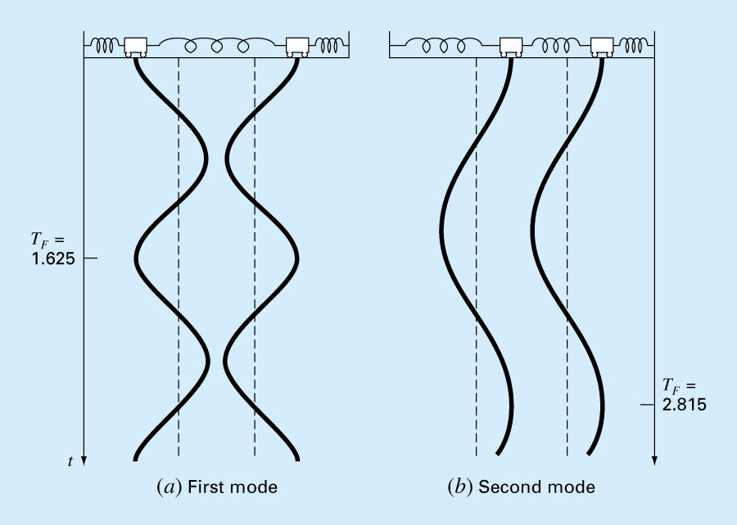
Principal Modes of Vibration
T_{p} = 1.62 s
X₁ = −X₂
T_{p} = 2.81 s
X₁ = X₂

Slide 11
Power Method
Power method for finding eigenvalues
Start with an initial guess for x
Calculate w = Ax
Largest value (magnitude) in w is the estimate of eigenvalue
Get next x by rescaling w (to avoid the computation of very large matrix A^{n} )
Continue until converged
Power method also gives you eigenvectors

Slide 12
Power Method
For large number of iterations, λ should converge to the largest eigenvalue

Slide 13
Example: Power Method
Consider
Assume all eigenvalues are equally important, since we don’t know which one is dominant
Start with
eigenvalue eigenvector

Slide 14
Example
Current estimate for largest eigenvalue is 21 Rescale w by eigenvalue to get new x
Check Convergence (Norm < tol?)
Norm

Slide 15
Update the estimated eigenvector and repeat
New estimate for largest eigenvalue is 19.381 Rescale w by eigenvalue to get new x
Norm

Slide 16
Example
One more iteration
Norm
Convergence criterion -- Norm (or relative error) < tol

Slide 17
Example: Power Method

Slide 18
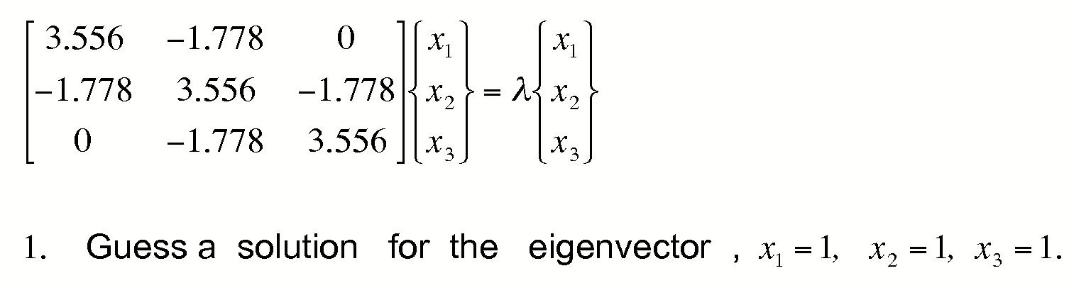
Example 02
Find the largest eigenvalue, using the Power Method

Slide 19
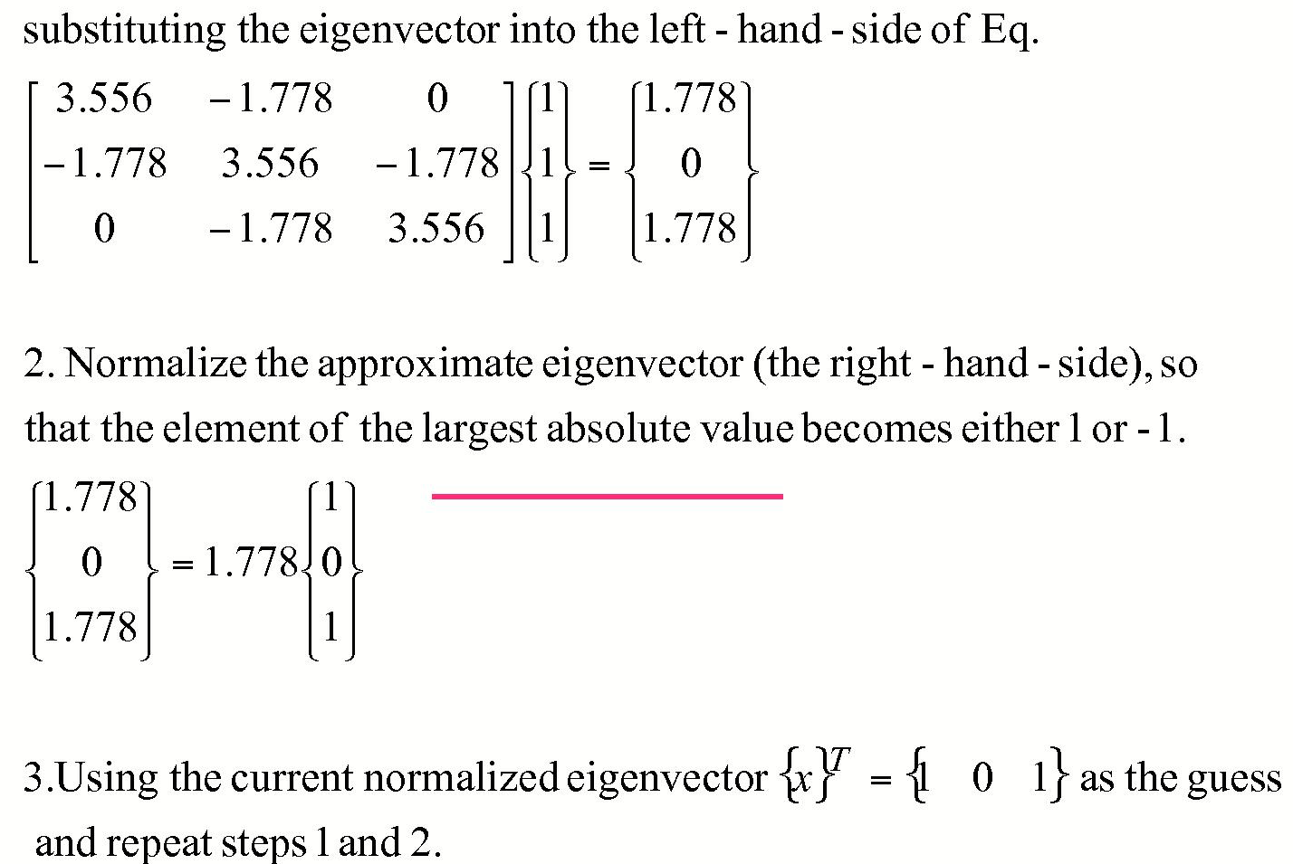
Example 02 of Power Method

Slide 20
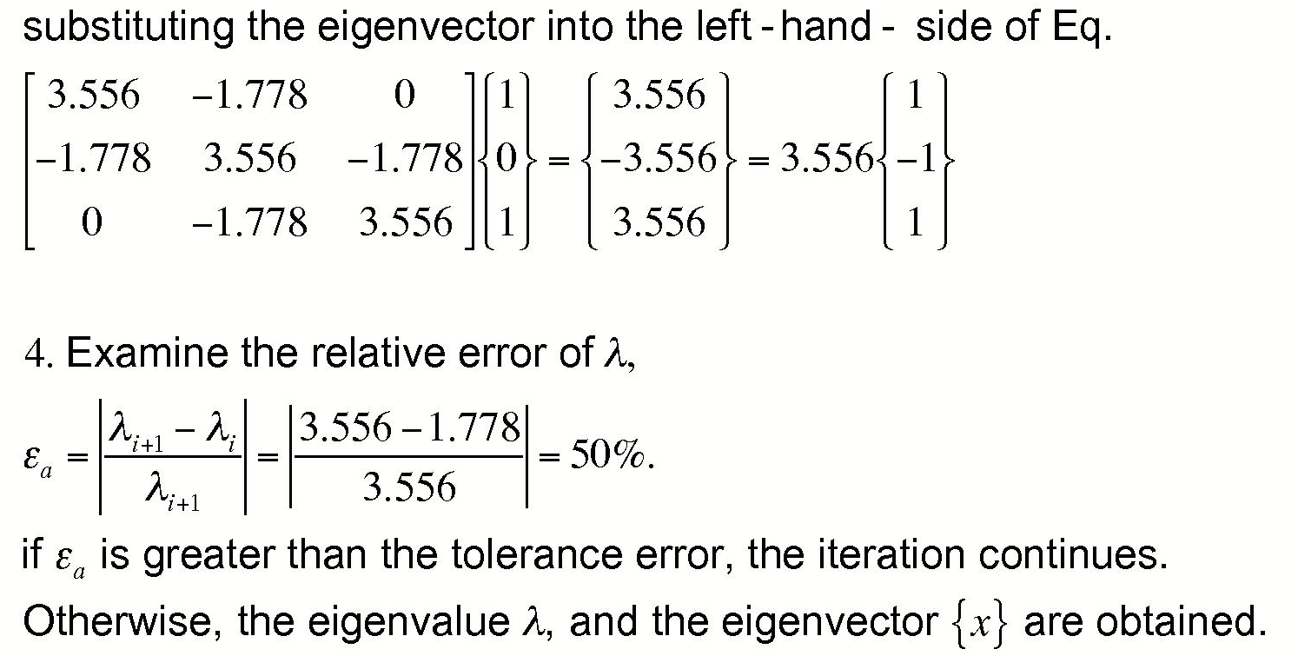
Example 02 of Power Method
Another stopping criterion

Slide 21
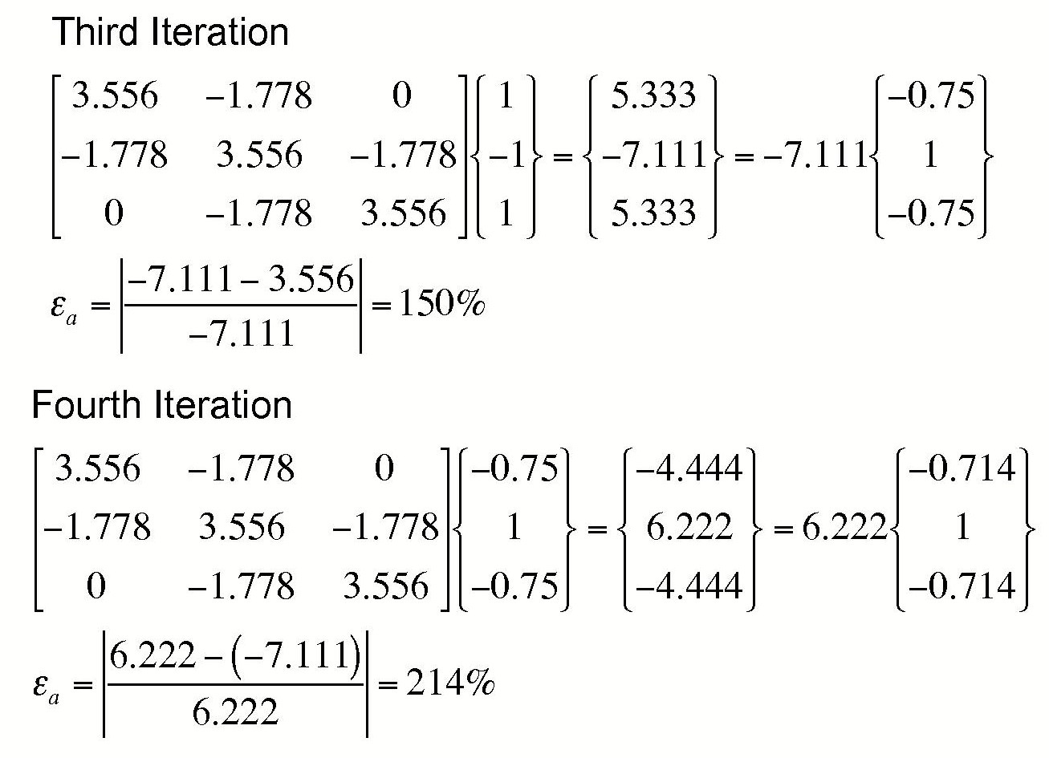
Example 02 of Power Method

Slide 22
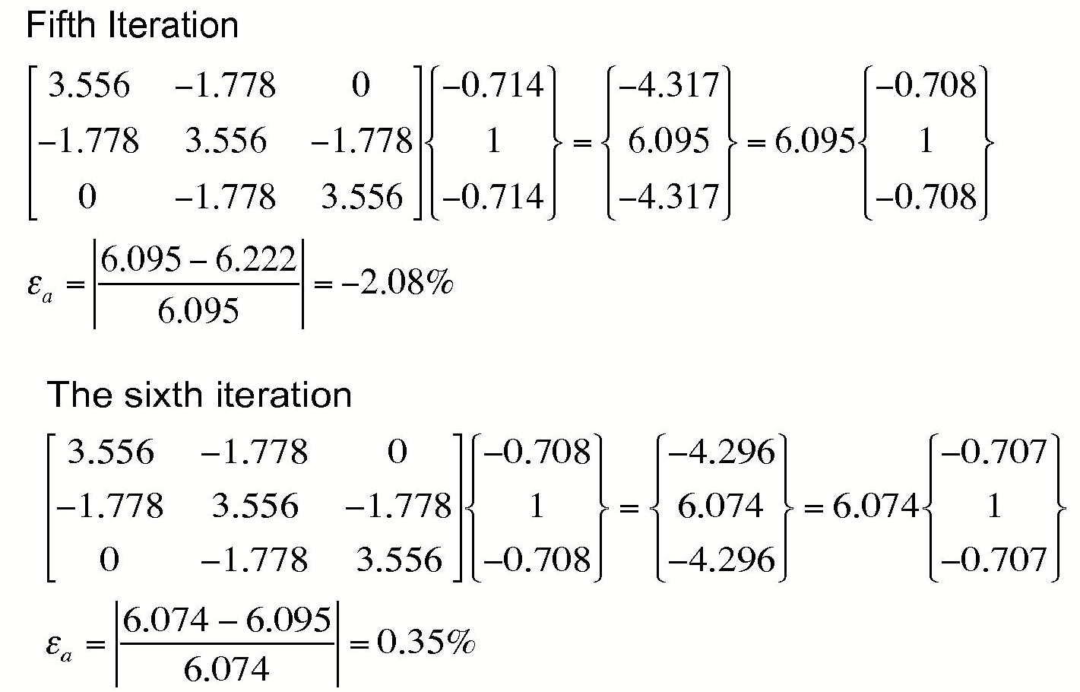
Example 02 of Power Method

Slide 23
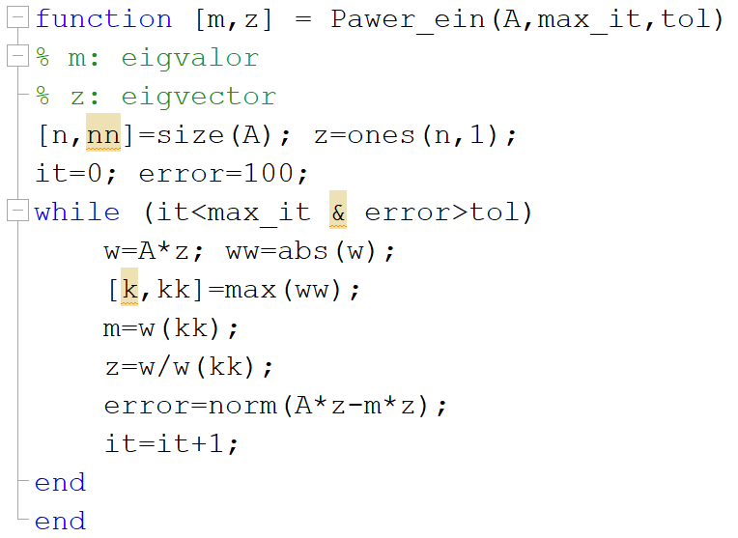
Matlab file: Power_eig.m

Slide 24
MATLAB’s Methods
e = eig(A)
gives eigenvalues of A
[V, D] = eig(A)
eigenvectors in V(:,k)
eigenvalues = D_{ii} (diagonal matrix D)
[V, D] = eig(A, B) (more general eigenvalue problems) (Ax = λBx)
AV = BVD

Slide 25
MATLAB Example:
Power Method
» A=[2 8 10; 8 3 4; 10 4 7]
A =
2 8 10
8 3 4
10 4 7
» [z,m] = Power_eig(A,100,0.001);
error =
8.3175e-004
» z
z =
0.9199
0.7085
1.0000
» m
m =
19.0322
» x=eig(A)
x =
-7.7013
0.6686
19.0327
eigenvector
eigenvalue
MATLAB function

Slide 26
Inverse Power Method
Power method give the largest eigenvalue
Inverse Power method gives the smallest
*Eigenvalues of B = A⁻¹ are inverse of eigenvalues of A (i.e., μ = 1/λ)
So one could use power method on w = Bx to get largest eigenvalue of B - smallest of A

Slide 27
Inverse Power Method
Basic power method gives the dominant eigenvalue
Inverse power method gives the smallest eigenvalue

